Slide 2
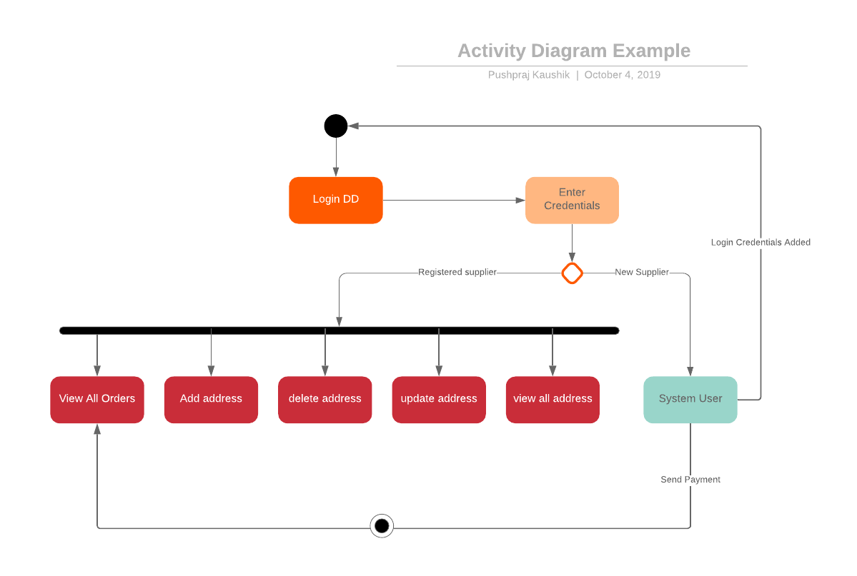
ACTIVITY DIAGRAM FOR SUPPLIER

Slide 3
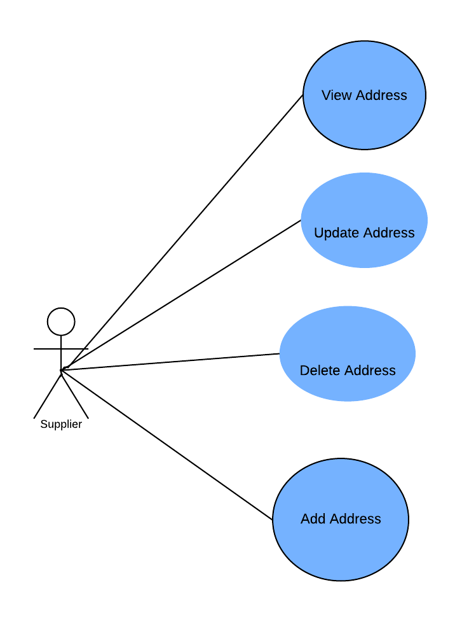
USE CASE DIAGRAM (SUPPLIER)

Slide 4
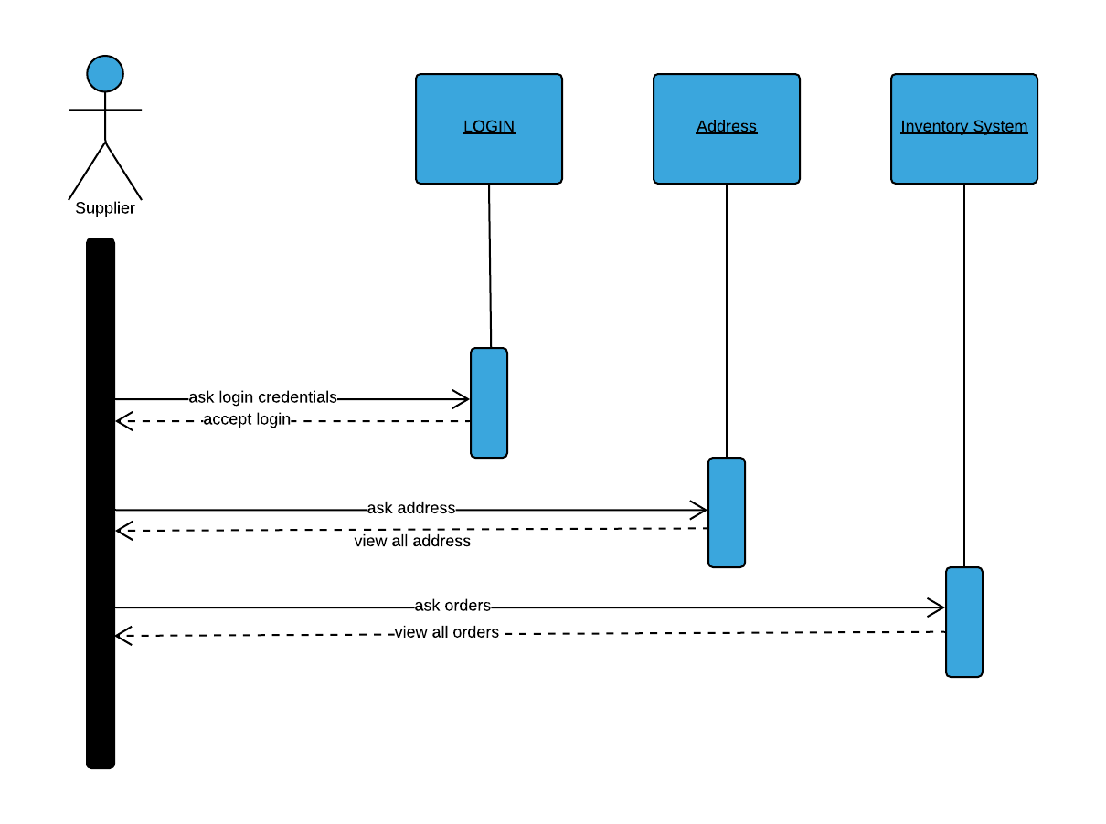
SEQUENCE DIAGRAM OF SUPPLIER

Slide 5
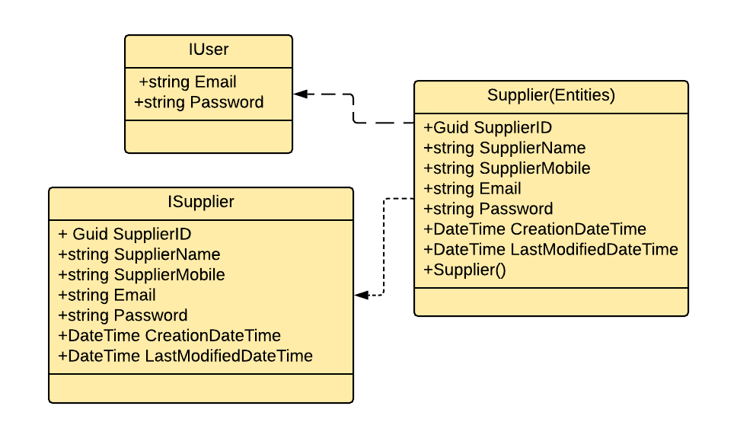
Class Diagram for Supplier Class

Slide 6
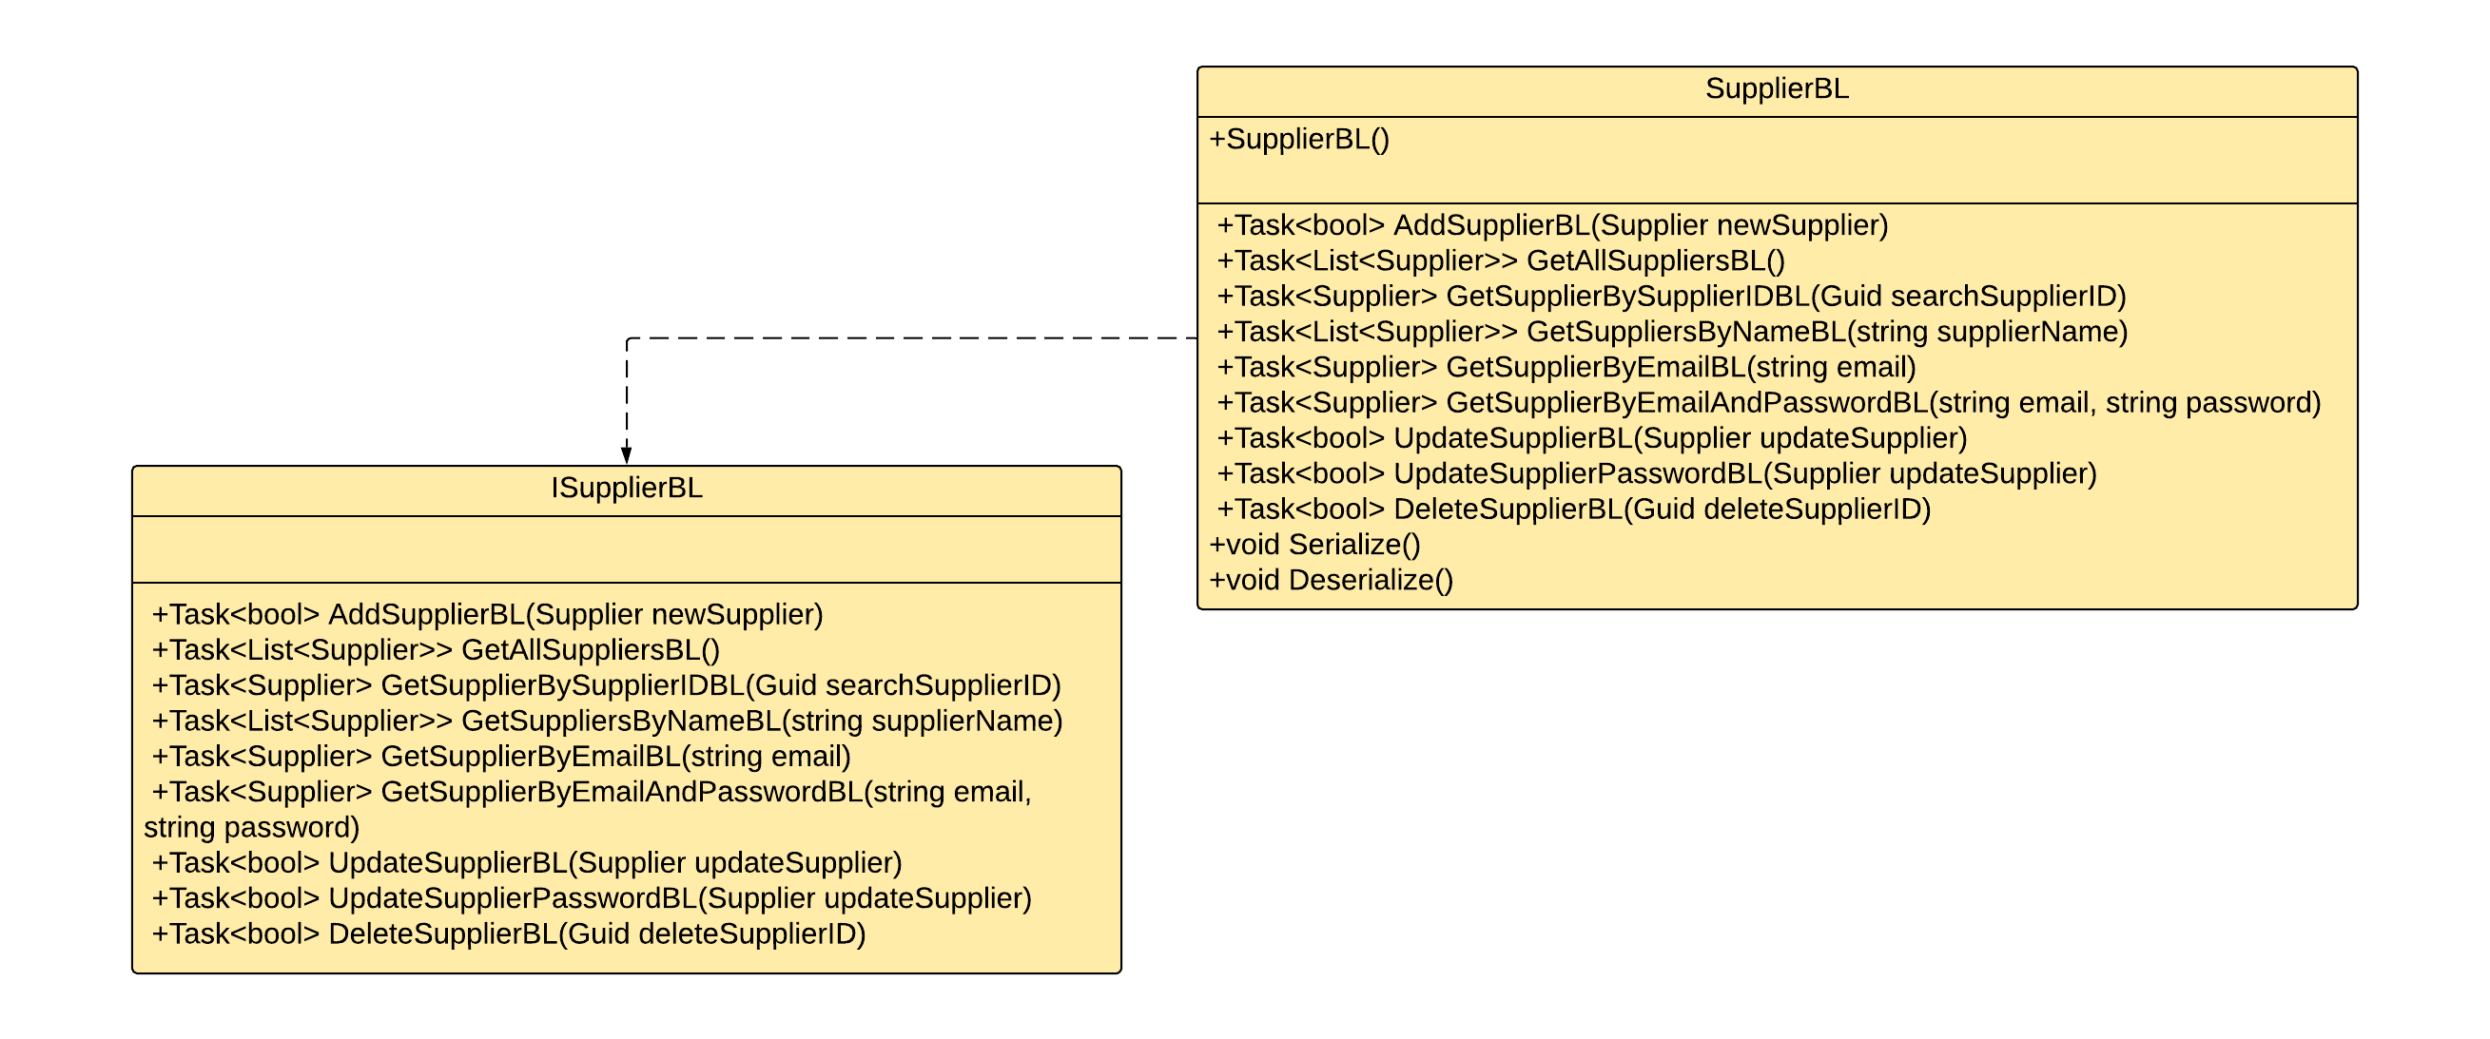
Class Diagram for Supplier Class

Slide 7
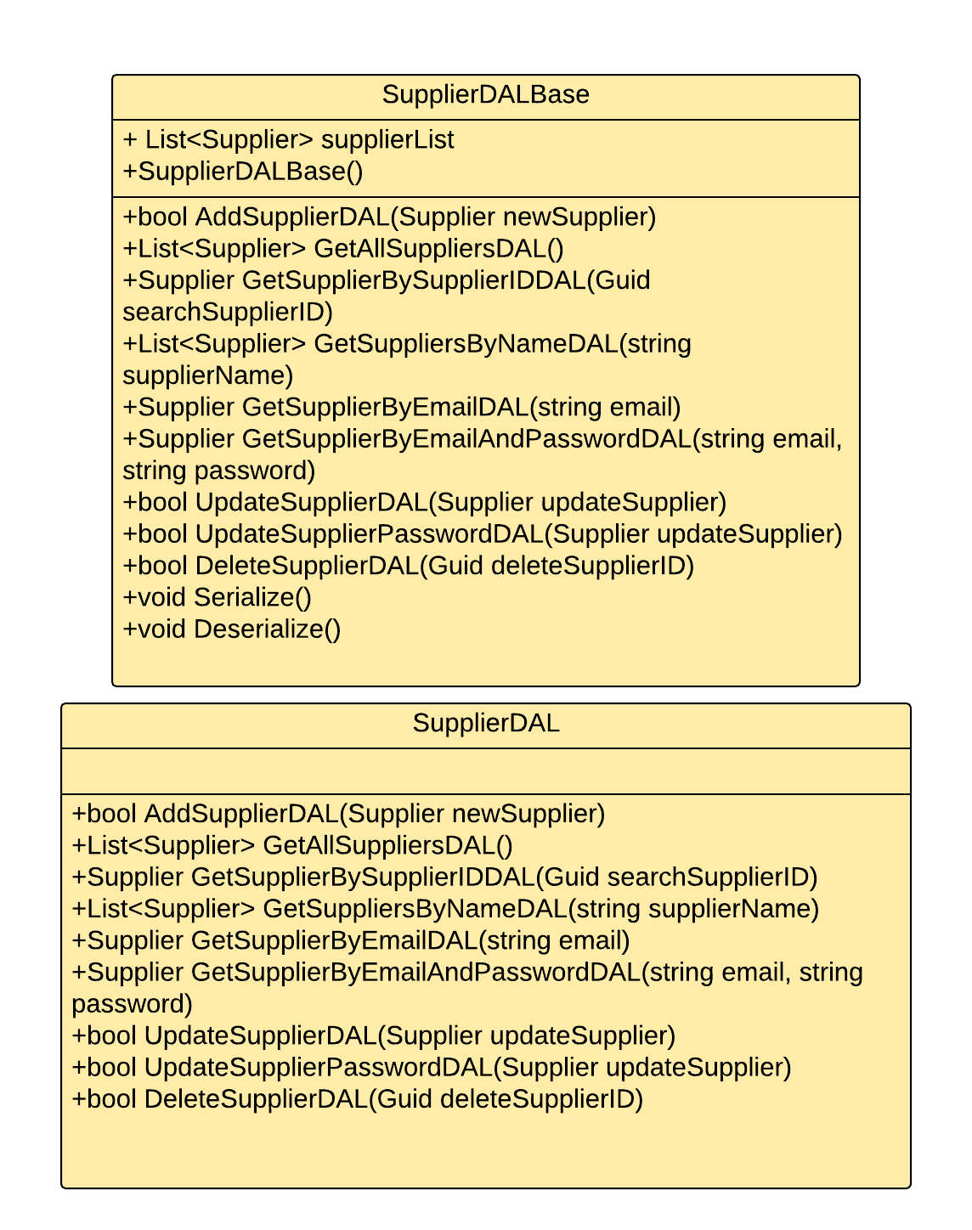
Class Diagram for Supplier Class

